Slide 1
Capstone Project - 3
Project Title – Coronavirus Tweet Sentiment Analysis
Team Members
Manjusree K C
Nivya T
Shaurabh Pandey

Slide 2
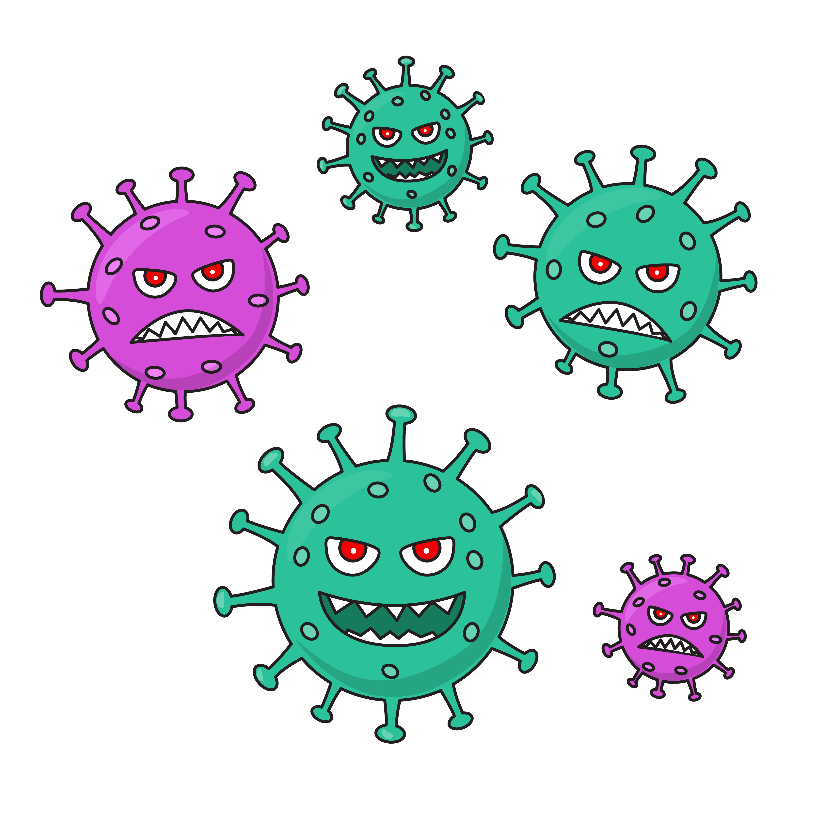
COVID 19
Coronavirus disease (COVID-19) is an infectious disease caused by the SARS-CoV-2 virus. It was discovered in December 2019, it is very contagious and has quickly spread around the world.
The virus can cause mild to severe respiratory illness, including death. The best preventive measures include getting vaccinated, wearing a mask, staying 6 feet apart, washing hands often and avoiding sick people
COVID-19 was declared a global pandemic on March 11, 2020. As of January 23, 2022, over 346 million cases including over 5.5 million deaths have been reported worldwide.
.

Slide 3

WHAT IS SENTIMENT ANALYSIS
Sentiment Analysis is the process of computationally identifying and categorizing opinions expressed in a piece of text, especially in order to determine whether the writer’s attitude towards a particular topic is Positive, Negative, or Neutral.

Slide 4

TWEET SENTIMENT ANALYSIS
Twitter is one of the most powerful social media platform in the world right now, which is used every day by people to express opinions about different topics, such as products, movies, music, politicians, events, social events, among others.
Tweets are often useful in generating a vast amount of sentiment data upon analysis. These data are useful in understanding the opinion of the people about a variety of topics.

Slide 5

PROBLEM STATEMENT
COVID 19 is a global pandemic that is still infecting millions of people around the world.
For this project we are provided with a coronavirus tweets csv file which contains more than 40000 tweets from people around the world on covid 19 and our aim is to analyze these tweets made on Covid-19 from around the world and predict the sentiment of each of the tweet by classifying them into three categories positive, negative and neutral.

Slide 6

OBJECTIVE
Analyze the tweets regarding COVID 19 and get insights regarding people’s sentiment.
To build classification models to predict the sentiment of COVID-19 tweets which have been pulled from Twitter.

Slide 7
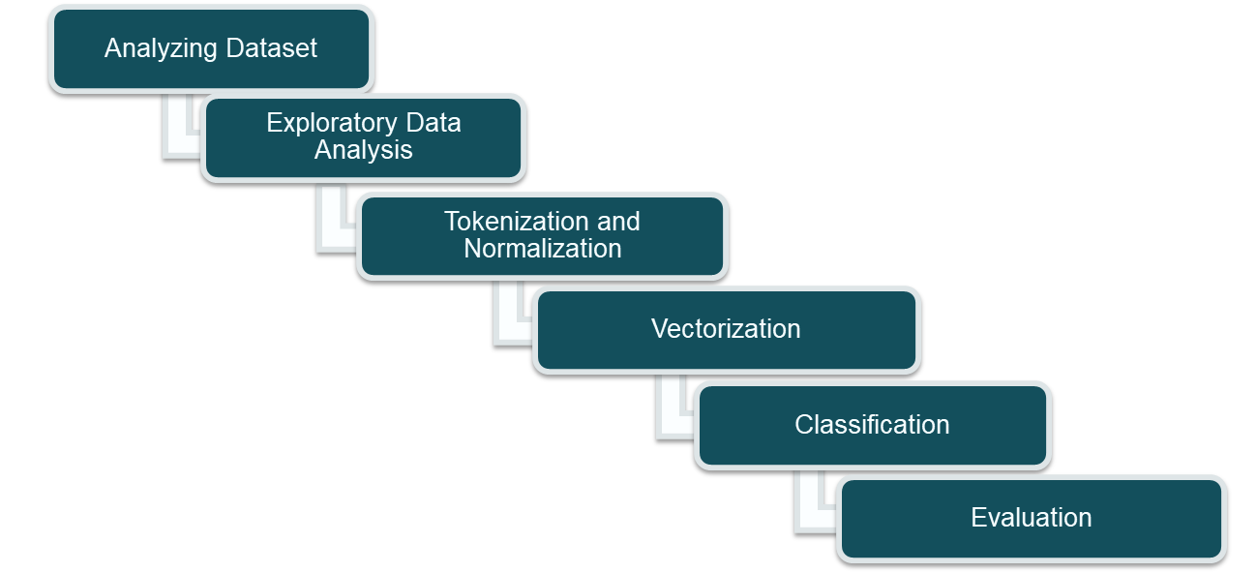
STEPS INVOLVED

Slide 8
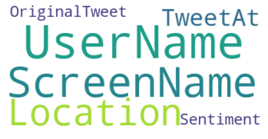
DEFINING THE VARIABLES
The shape of the dataset is (41157, 6).
Username : The username of the person on twitter
Screenname : The screenname of the person on twitter
Location : The location from where the tweet was tweeted
TweetAt : The date of the tweet
OriginalTweet : The tweet itself unfiltered
Sentiment : The sentiment of the tweet our target variable
The target variable is ‘Sentiment’.

Slide 9
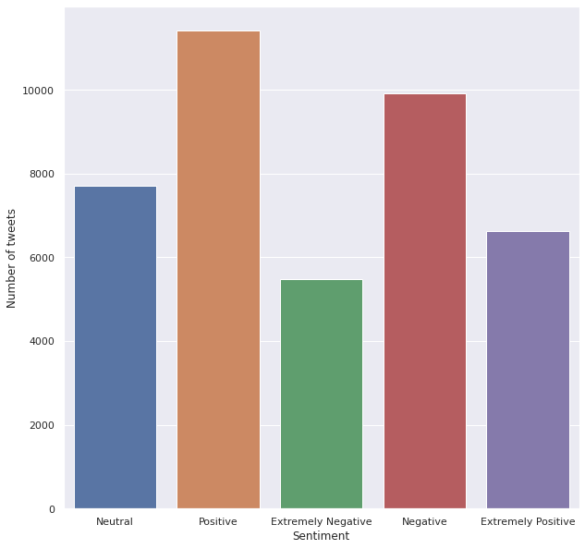
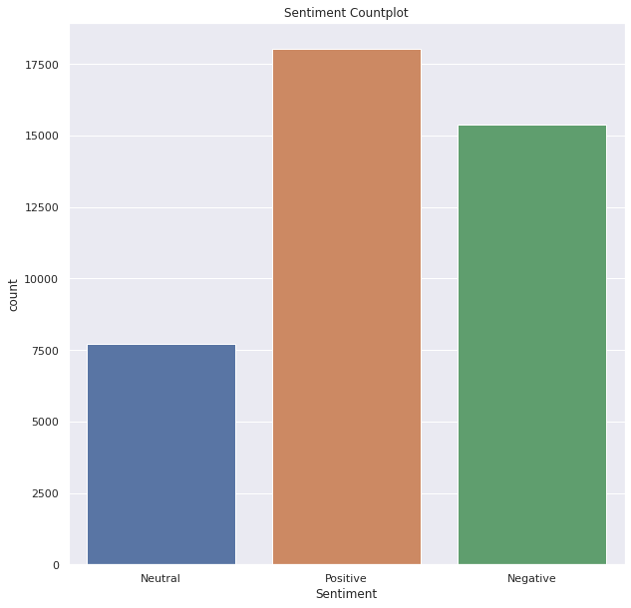
TARGET VARIABLE STUDY

Slide 10
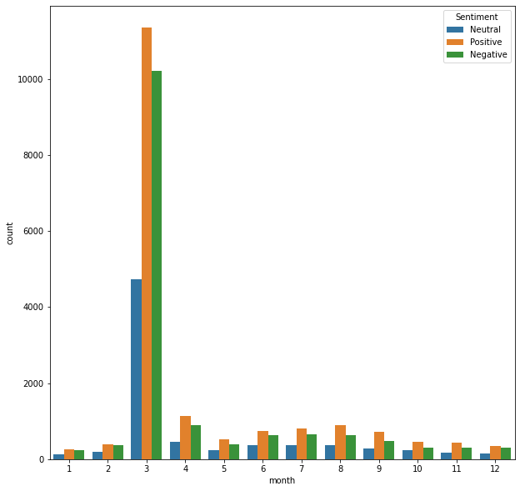
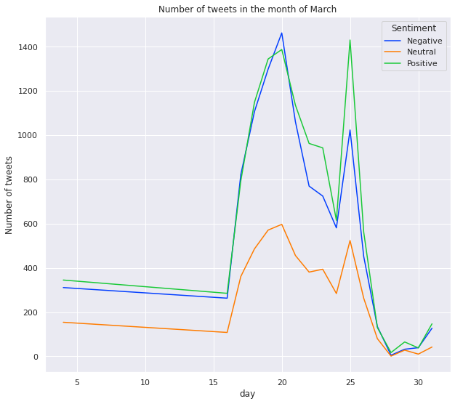
DATE ANALYSIS
Majority of the tweets in our record are from the month of march whereas for all other months the number of tweets are more or less constant.
In the month of march from around the start of second week we can see a rise in number of both positive and negative tweets, and this continues till around 26th of march.

Slide 11
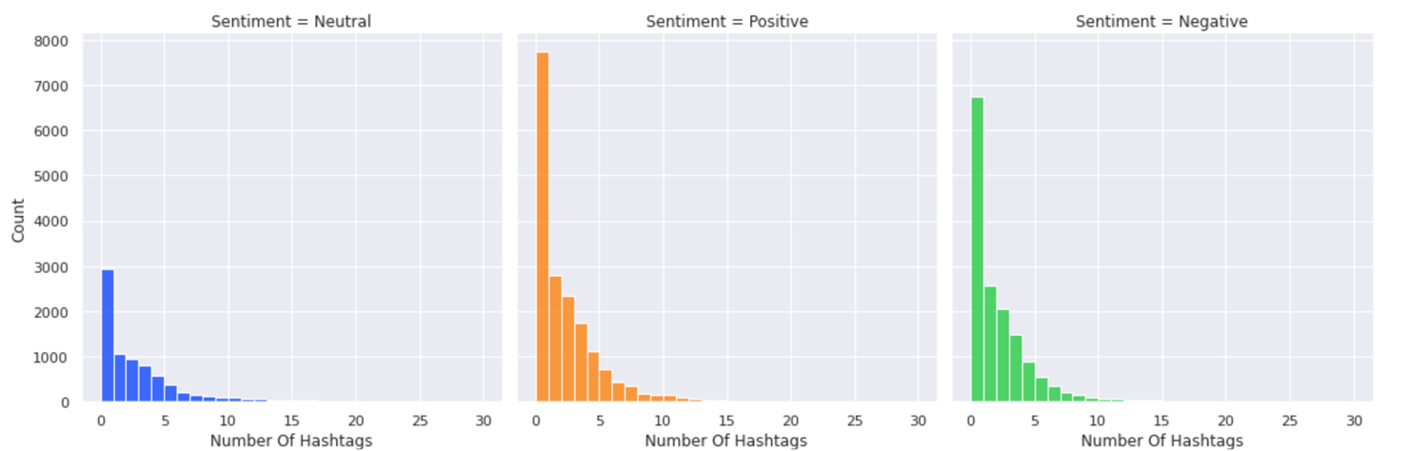
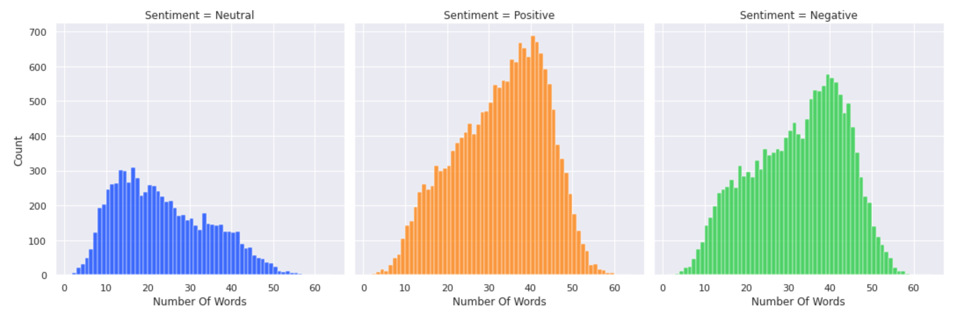
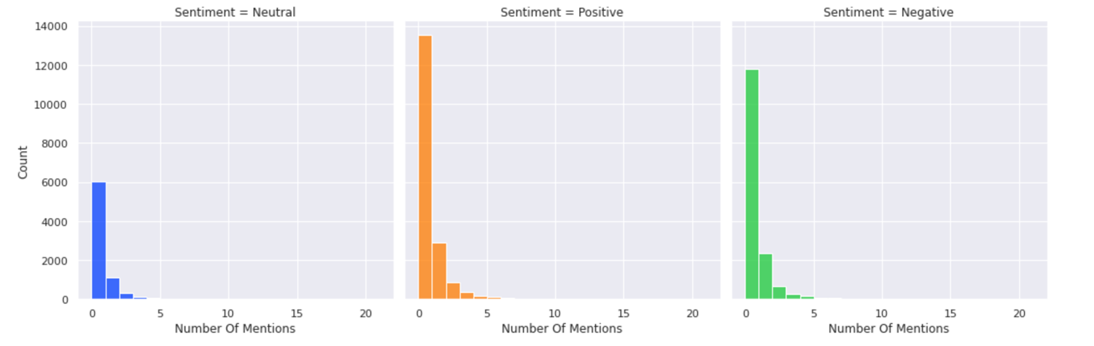
Tweets Analysis (Words)
Tweets Analysis (Hashtags)
Tweets Analysis (Mentions)

Slide 12
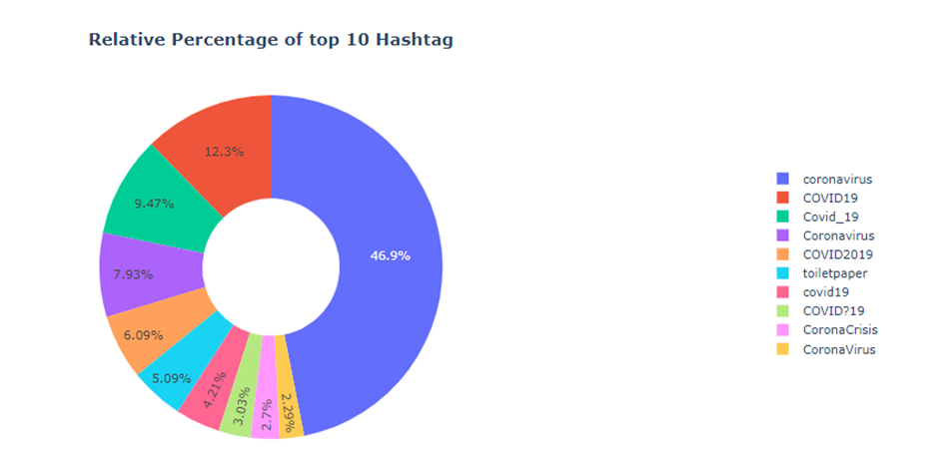
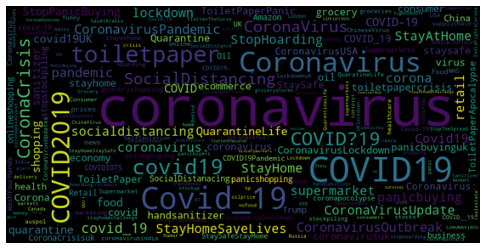
HASHTAG ANALYSIS

Slide 13
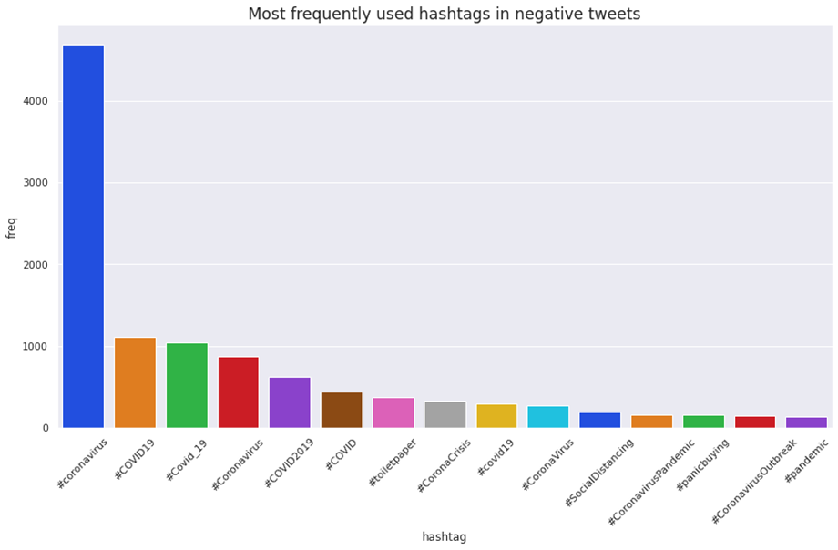
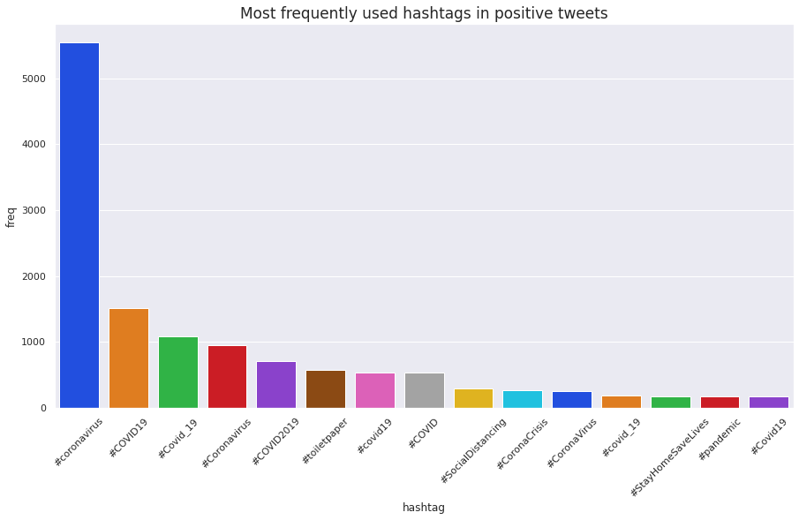
MOST FREQUENT HASHTAGS
The most used hashtags are different versions of the name Corona virus itself.
#StayHomesaveLives is much more used in tweets of positive sentiment than the negative sentiment tweets. On the other hand, hashtags like #panicbuying are more frequently used in negative sentiment tweets.

Slide 14

TEXT PREPROCESSING
Tokenization
Lemmatization
Vectorization

Slide 15
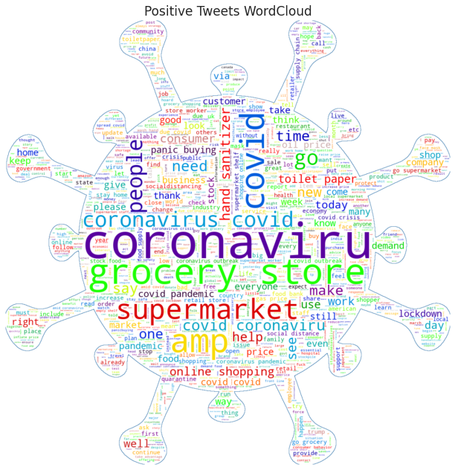
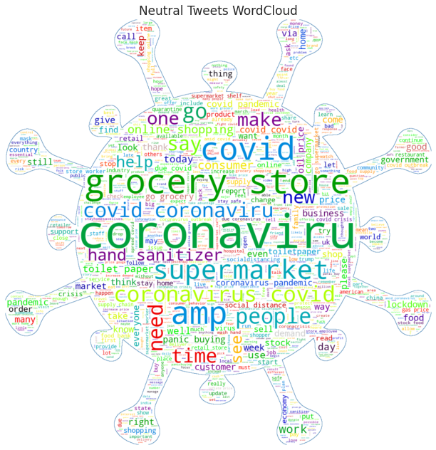
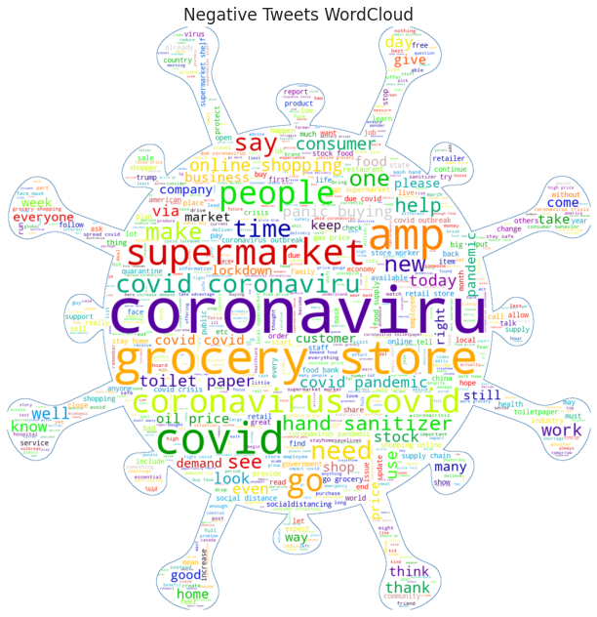
TWEET WORDCLOUD
In all the tweets, irrespective of the sentiment the most frequently used words apart from the name of the pandemic are supermarket, grocery store, toilet paper, online shopping, food and price which signals how much of a significant cause of concern it was for the people even to get basic day to day items during the pandemic.

Slide 16
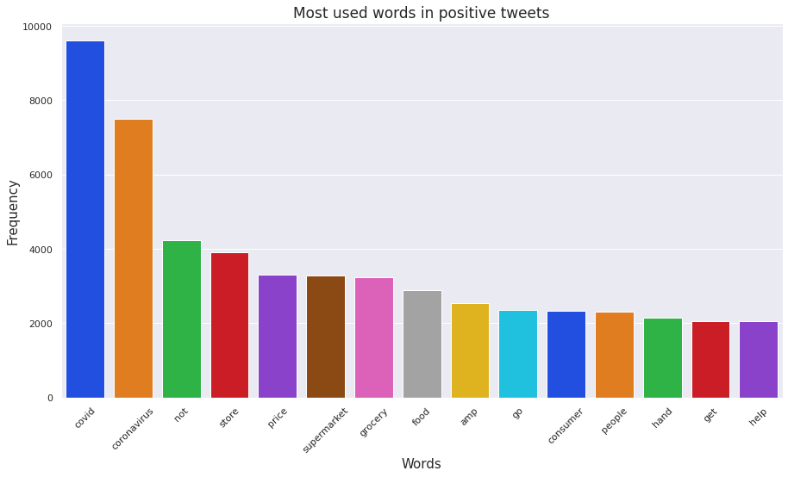
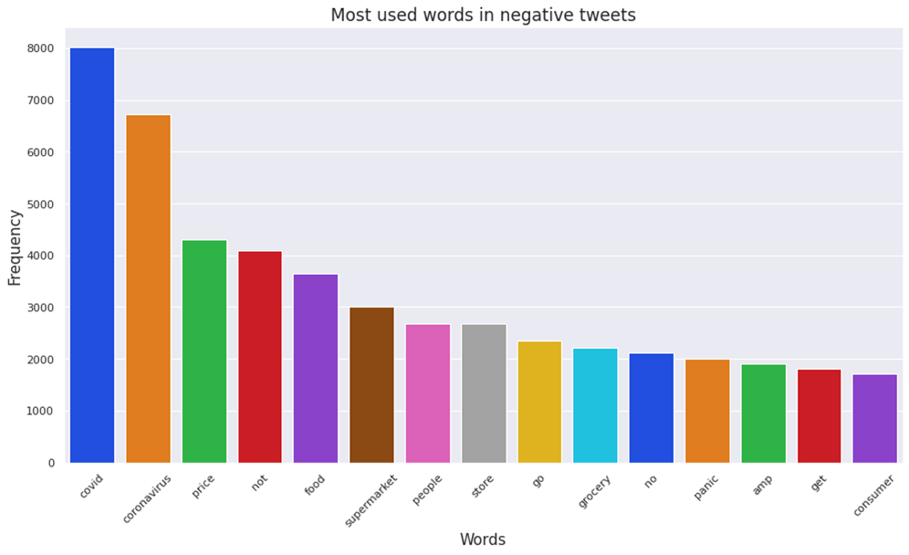
MOST FREQUENT WORDS IN TWEETS
Positive tweets include words like store, grocery, supermarket, food, and price.
Words like food, groceries, supermarkets can also be found on the graph of negative tweets. Panic is a key word here, but it does not appear on the graph of positive tweets.

Slide 17
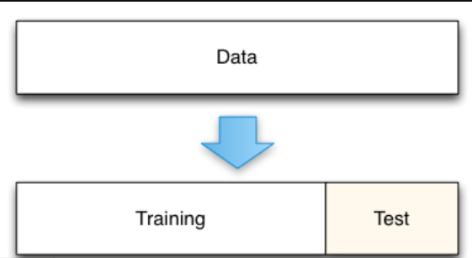
Task : Classification Train Set:- (32925,5198) Test Set:- (8232,5198)
PREPARING DATASET FOR MODELLING

Slide 18
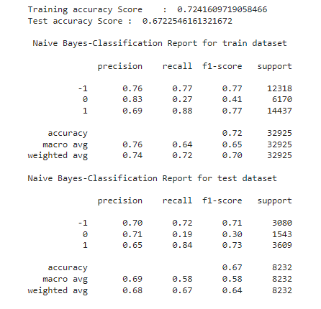
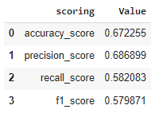
APPLYING MODEL (BASELINE MODEL)
Our Baseline Model is Multinomial naive bayes which gives an accuracy score of 0.672, which is a low score. The recall value for neutral labels is pretty low for this model.

Slide 19
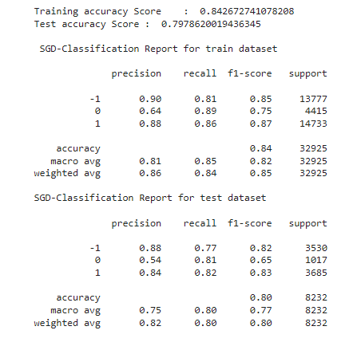
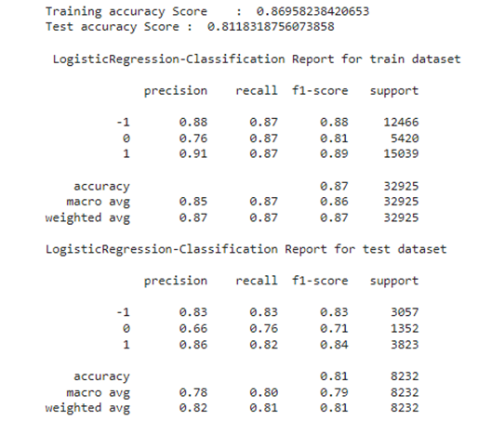
Model validation & Selection (Multinomial)
Stochastic Gradient Descent
Logistic Regression

Slide 20
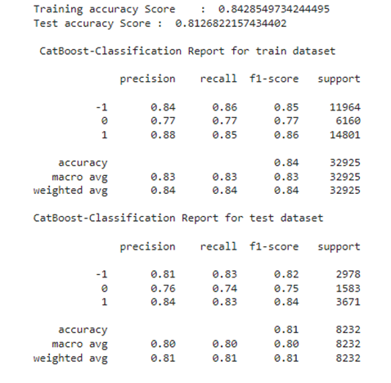
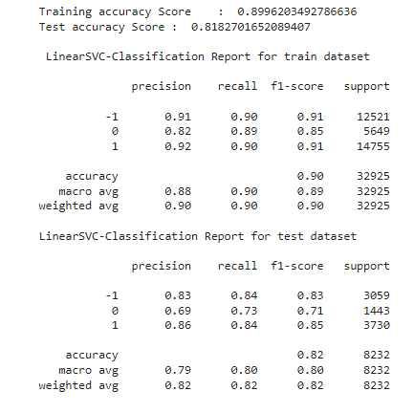
Model validation & Selection (Multinomial)
CatBoost
Linear Support Vector Classifier

Slide 21
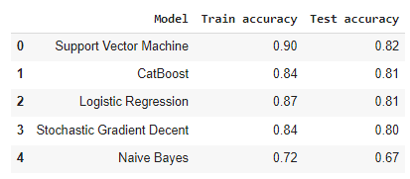
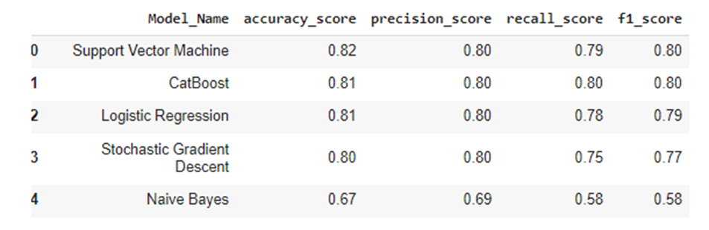
MODEL VALIDATION AND SELECTION (MULTINOMIAL)

Slide 22
OBSERVATIONS
The scores of Multinomial Naive Bayes are the lowest across all the metrics.
Linear support vector machine has the highest test accuracy compared to other models.
Recall score of CatBoost model is highest among all.
Considering the overall performance and computation time we have chosen Linear support vector classifier as our model for multinomial classification.

Slide 23
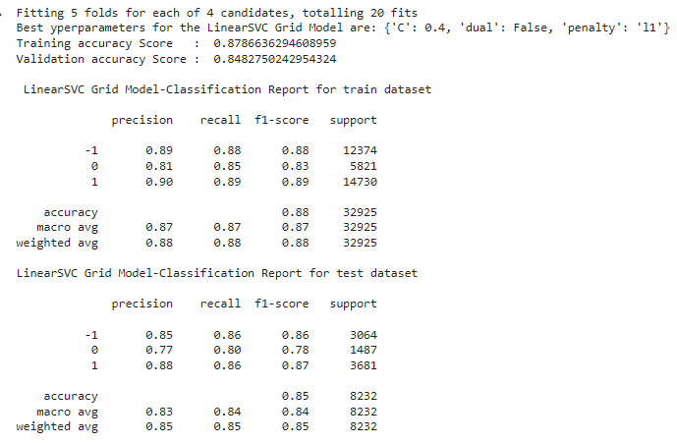
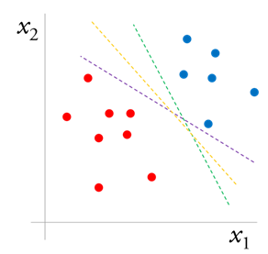
LINEAR SVC AFTER CROSS VALIDATION AND HYPERPARAMETER TUNING
We have chosen Linear Support Vector classifier as the best model for our predictions

Slide 24
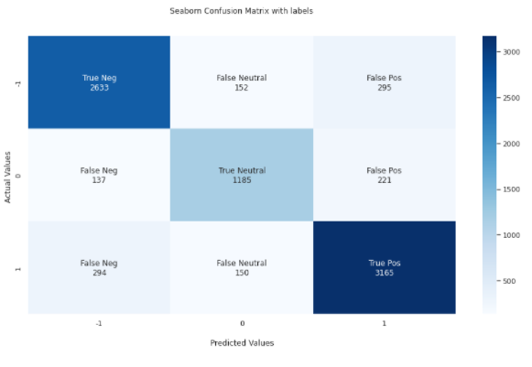
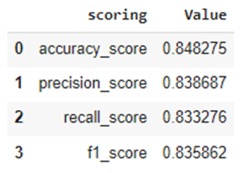
LINEAR SVC AFTER CROSS VALIDATION AND HYPERPARAMETER TUNING

Slide 25
CONCLUSION
Among the 5 classification algorithms we performed, Naïve Bayes fails to be effective.
The other 4 models SVM, SGD, Logistic Regression, and CatBoost perform well on the test data, SVM being the best model.
Linear SVM with 85% accuracy after cross-validation and hyperparameter tuning performed well for multinomial classification.
We hope this project will be helpful for the Government and NGOs to take adequate measures in policy making and rehabilitation respectively.
Various profit organizations can make profit through the production and distribution of essential items during the pandemic by analyzing various sentiments

Slide 26
Thank you

